Slide 1

Instrument Data Processing
MMR September 2020
AMMOS Technology
Jack Lightholder

Slide 2
Instrument Data Processing (CODEX)
Schedule
ID | WBS | CAM | Task Name | % Complete | Duration | Planned Start | Actual Start | Finished
375 | 05.01.13 | JLightholder | CODEX - Complex Data Explorer | 100% | 224 d | Tue 10/1/19 | Tue 10/1/19 | Fri 9/25/20
376 | 05.01.13 | JLightholder | Design and Implement "Data Quality Scan" User Interface | 100% | 62 d | Tue 10/1/19 | Tue 10/1/19 | 12/31/19
377 | 05.01.13 | JLightholder | Feature Bar Extension to Support Multiple Interaction Windows | 100% | 40 d | Thu 1/2/20 | 1/2/20 | 2/28/20
378 | 05.01.13 | JLightholder | Extend Server Data Reader Capabilities to for Additional Data Types | 100% | 33 d | Mon 3/2/20 | 3/1/20 | 4/15/20
379 | 05.01.13 | JLightholder | Extend Runtime Prediction Model to Support Features/Samples in Calculation | 100% | 22 d | Thu 4/16/20 | 3/1/20 | 3/15/20
380 | 05.01.13 | JLightholder | Design and Implement "Model Training" User Interface | 100% | 20 d | 3/15/20 | 3/15/20 | 4/1/20
381 | 05.01.13 | JLightholder | Enable Session Saving / Loading | 100% | 33 d | Tue 6/16/20 | NA | 7/1/20
382 | 05.01.13 | JLightholder | Enable Data / Code / Selection / Feature Export | 100% | 17 d | Mon 8/3/20 | NA | 7/12/20
383 | 05.01.13 | JLightholder | Advanced User Guidance Through Dynamic Error Reporting | 100% | 22 d | Wed 8/26/20 | NA | 8/15/20

Slide 3
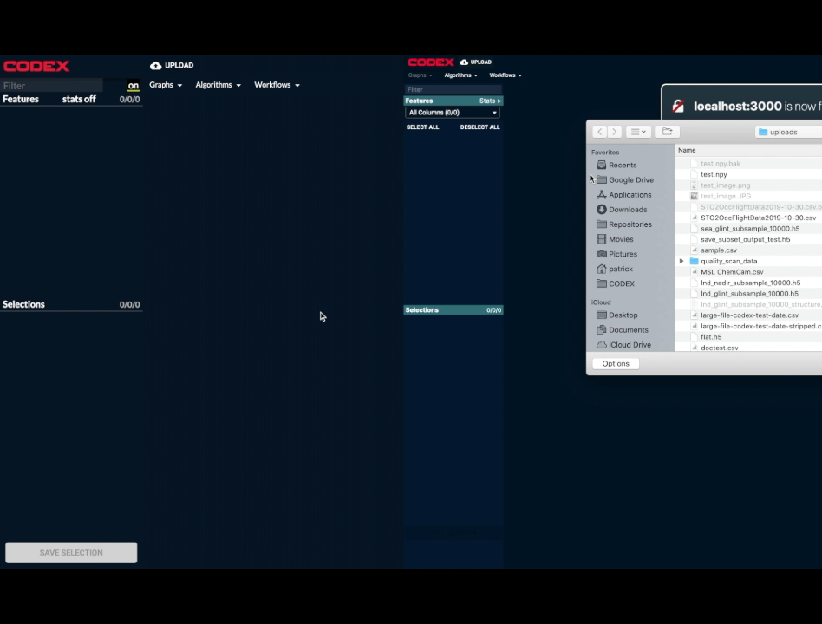
CODEX
Application Speed Improvements
100x speed improvement to plotting responsiveness.
Critical to maintain intuitive user exploration.
Long load times prompt users to do other things and lose track of their workflow
Required architectural improvements which bottlenecked new research and general product usability
Saved until last so multiple rounds of optimization were not necessary.
Enables streaming machine learning applications in future versions of the tool.
Movie showing speed improvements to plotting responsiveness

Slide 4
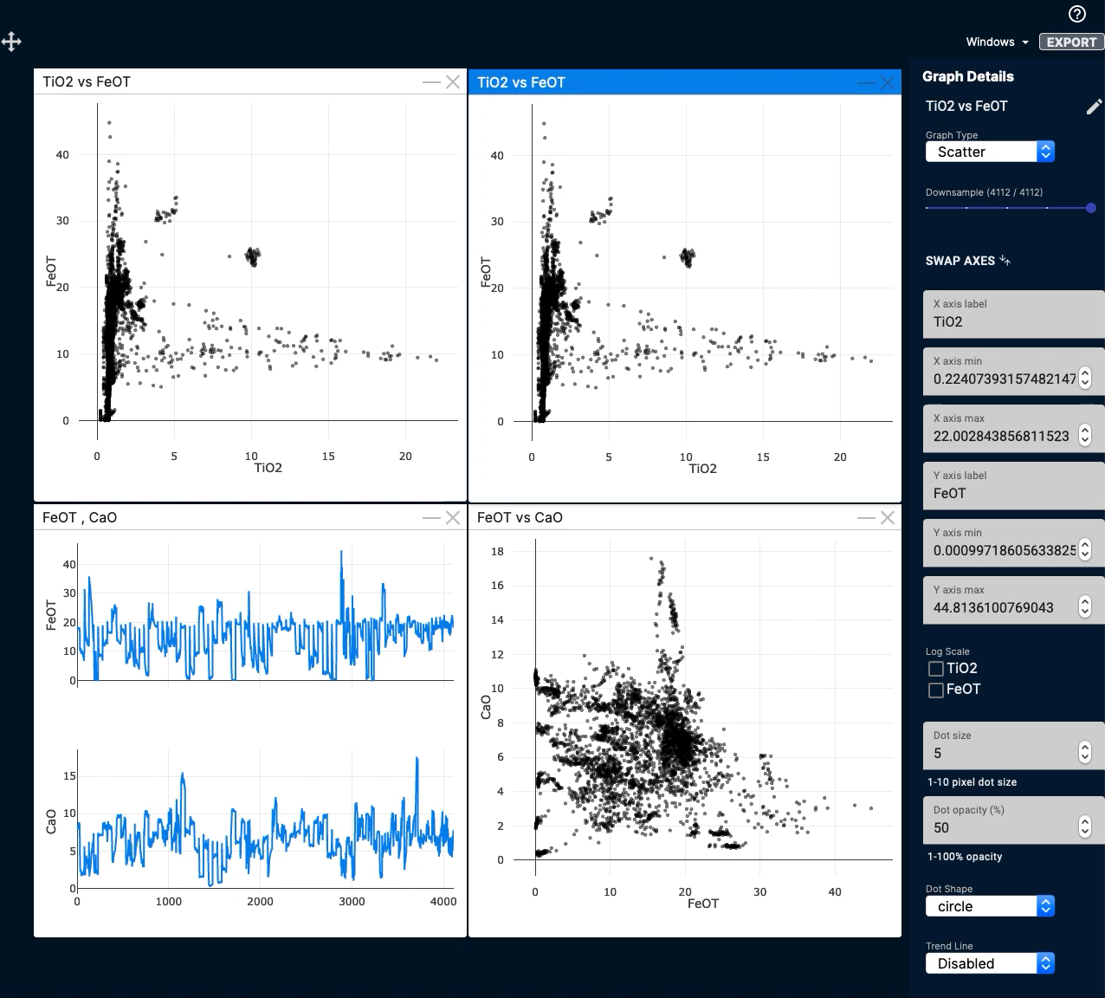
CODEX
User Driven Data Downsampling
Users can now select downsampling rates per-plot.
Allows for rapid, lower fidelity, exploration of the data before committing to larger computation times on full resolution data.
Required architectural changes to support, allow machine learning outcomes on downsampled data to be carried over to full resolution dataset.
Closes out large scale architectural optimizations necessary to support datasets large enough to be useful in real world analysis.
Movie showing downsampling options driven by user controls. Allows for rapid exploration on large datasets

Slide 5
CODEX
Infusion Status
SDDA User Testing and MSL Infusion Program
Provide MSL operations teams with a suite of supporting data science programs and quantify improvements to their workflow
Validating gap analysis of the FY19 SDDA report
Program suite:
ORCHIDS – data alignment and re-gridding to make data ingestable by all downstream products.
TelemAnom – semi-supervised anomaly detection. Provides focus of attention tool for which time regions operators might be interested in.
RAVEN – large scale data visualization dashboard. Allows operators to view large time/feature regions to further isolate data of interest
CODEX – deeper analysis support on isolate data set. Allows mission operators to conduct a deeper analysis on isolated data and isolate cause/effect.
Conducting user studies with 10 MSL team members.
Strategic data analysis – answer questions with low resolution data across a large time region
Tactical data analysis – answer questions with high resolution data across a short time region
Providing findings report too SDDA and MSL mission management

Slide 6
CODEX
Plans for Next Year
Formalize user-facing data-science and ML content: guidance, interface optimizations, simple deployment/installation
Data scaling to allow broad views of large data sets and detailed analysis of smaller subsets
Use selections to restrict the scope of analysis (“this is good data”)
Feature mathematical manipulation page (new feature = feature_1 * feature_2 / feature_3)
ML to anticipate upcoming problems based on unusual new time-series trends using active labeling (“More like this”)
Linking between algorithms and plots (e.g., 1. find correlation 2. use those correlations to visualize unusual events in a time series plot)
Improved regression with sensitivity analysis guidance
Improved understanding through feature importance interface

Slide 7
CODEX
Financial Status
Complex Data Explorer
Actual YTD costs are $175K versus plan of $175K
All FY20 tasks were completed last month, this month has just been wrap up
Pending cost transfer out of CODEX will bring budget to ~175k, as intended
Employee from another AMMOS task was incorrectly charging to the CODEX account after being incorrectly WAMed.

